Slide 1
Reducing Redux Abstractions
Alexander Pittendrigh

Slide 2
Redux
Predictable state container for JavaScript applications
Works anywhere JavaScript runs
Primarily used on the web, when state management becomes a chore
react-redux (https://github.com/reduxjs/react-redux)
ngrx (https://github.com/ngrx/store)
vuex (https://github.com/vuejs/vuex)

Slide 3
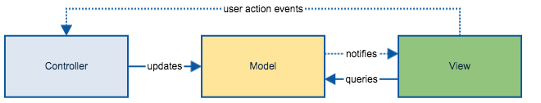
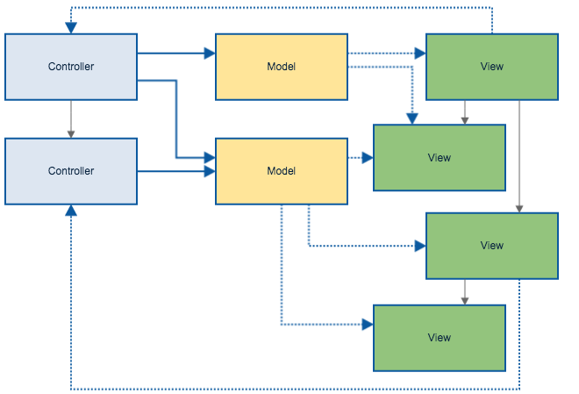
What’s wrong with traditional state management?
Everything changes everything

Slide 4


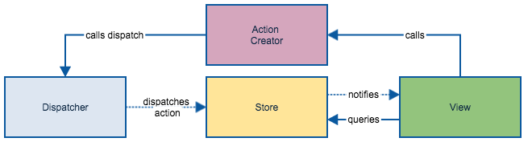
Flux Pattern

Slide 5

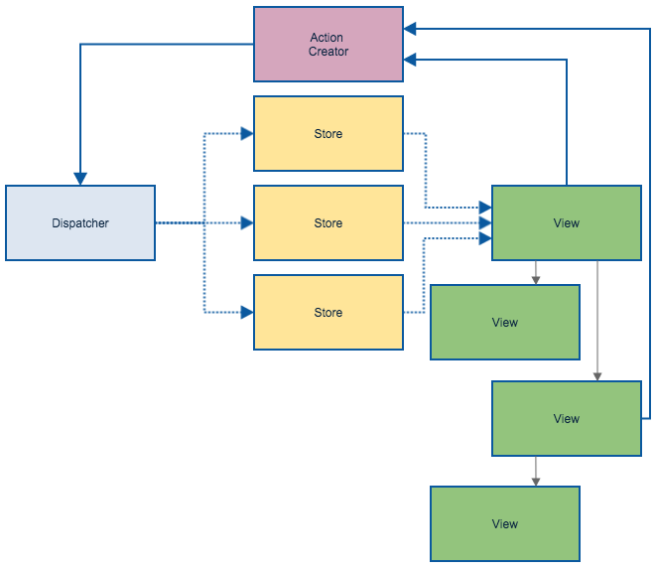

Slide 6
Why?
Unidirectional data flow
Every change of state has only one easily trace-able, corresponding action
Action handlers are synchronous
Inversion of control
Action handlers are pure
Action handlers are easy to test, because they’re pure
On your website you can test state modifications without seeing state as a reflection of your DOM.

Slide 7
Redux
Reducer
Dispatch
Store, Action
Store
Action
Component
Component
Component
Component

Slide 8

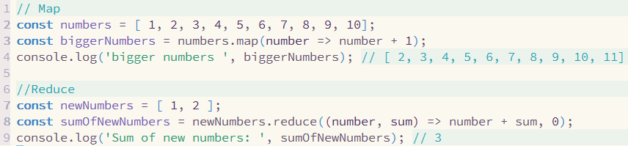

Reducer?

Slide 9
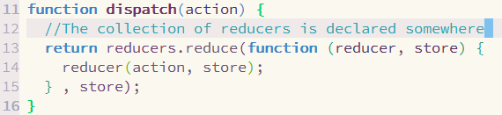
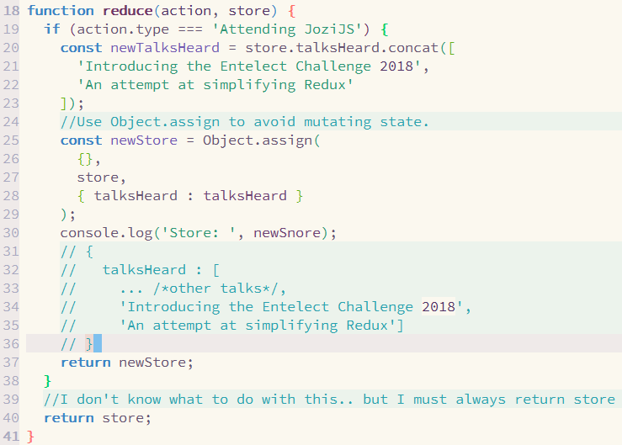
Dispatch
Store, Action
Reducer

Slide 10
Action Reducers in Redux
Take an action and a state, return a new state
Your application state is a reduction of the actions
Each reducer operates on a subset of the global state

Slide 11
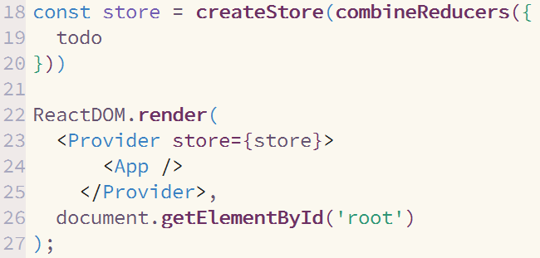
WRAP YOUR APP!

Slide 12
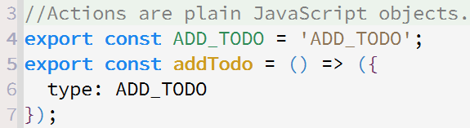
DISPATCH ACTIONS TO MODIFY STATE

Slide 13
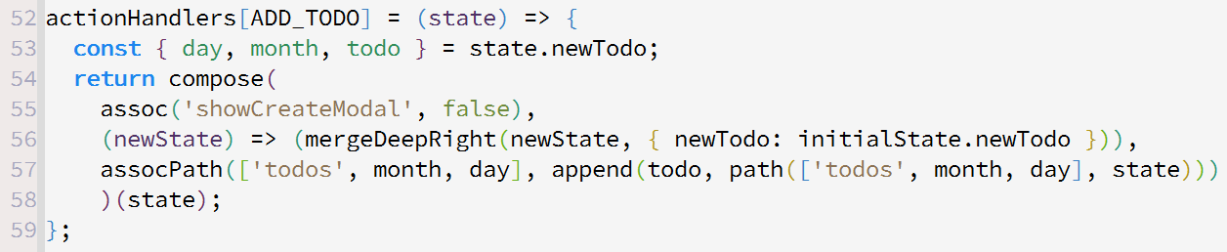
Tell reducer how to handle action

Slide 14
Best practices
Reducers must always be pure
Use reducer composition
Name each action constant as <NOUN>_<VERB>
Use create reducer

Slide 15
Async actions
Use redux thunk - https://www.npmjs.com/package/redux-thunk
Or use redux sagas - https://github.com/redux-saga/redux-saga

Slide 16
Q&A
https://twitter.com/Alexander_za
On ZATech Slack: alexp
a.pittendrigh@gmail.com
https://github.com/a-pittendrigh/Talks/tree/master/Redux
https://github.com/a-pittendrigh/

